Slide 1
Srinivas Jandhyala
Sanjay K Balupala
Vishnu NKV
September 2014
Product Maintenance Training (PMT)
IBM Case Manager 5.2.1
Solution Development:
Usability and Performance Improvements

Slide 2
Introduction
Course Overview
  Solution Development: Usability and Performance improvements
Target Audience:
  Solution Administrators, Application Developers
Suggested Prerequisites:
  Knowledge of IBM Case Manager 5.2
Version Release Date: September 2014
© Copyright International Business Machines Corporation 2014
. All Rights Reserved.
US Government Users Restricted Rights - Use, duplication or disclosure restricted by GSA ADP Schedule Contract with IBM Corp.

Slide 3
Course Objectives
After this course you will be able to know the following improvements made in Case Builder as part of ICM 5.2.1,
Task Properties and In-basket improvements
Identify the usability and performance improvements in the Case Builder
Embedded Rules improvements
Know how to take advantage of these enhancements

Slide 4
Course Roadmap
  Task property support and In-basket improvements
  Unlock solution artifacts when there are no changes
  Reflect reused property updates from Target Object Store
  LTPA token expiry handling
  Solution design performance improvements
  Embedded rules improvements

Slide 5
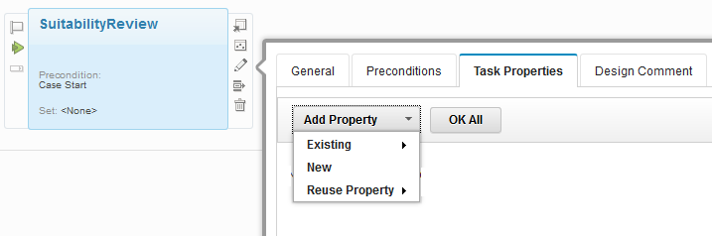
Defining Task Properties
Task properties are defined at the Task level
Task property can be added using the following options
  New Property
    When a New property is added to a Task, it is added automatically to the solution as well
  Existing Property
    Existing solution property is added to a Task
  Reuse Property
    Property from TOS is added as s Reused properties
Task Properties Tab - New in 5.2.1

Slide 6
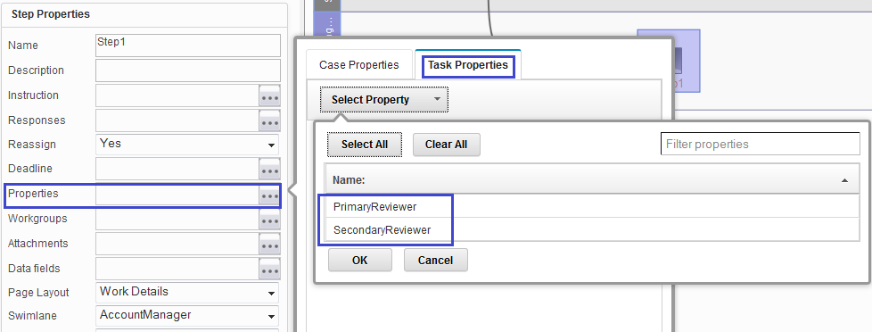
Task Properties association in Step Designer
You can choose to associate Task properties at step level in Step Designer
New 'Task Properties' tab provided along with Case properties

Slide 7
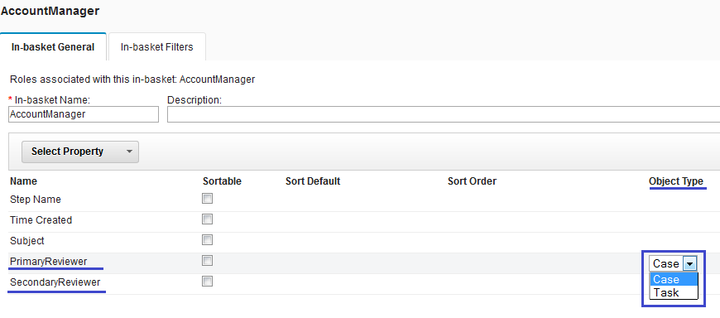
Properties “Object Type” definition in In-basket
In earlier releases, just Solution properties can be associated to Inbasket.
In 5.2.1, Not only you can add a Solution property to an Inbasket, but you can also define its Object Type of “Case” or “Task”.
The new 'Object Type' drop down allows to choose the “type” of a property
'Object Type' can be set to either 'Case' or 'Task'. Default is set to 'Case'.
'Object Type' selection is available at In-basket Filter level also

Slide 8
Course Roadmap
  Task property support
  Unlock solution artifacts when there are no changes
  Reflect reused property updates from Target Object Store
  LTPA token expiry handling
  Solution design performance improvements in Case Builder
  Embedded rules improvements

Slide 9
Unlock the Solution Artifacts when no changes are done
In the earlier releases of Case Builder, the artifacts of the Solution were getting locked even when a user opened and closed, just to view them.
We were not releasing the locks when no changes were done to them and this caused unnecessary overhead of maintaining the locks.
In 5.2.1, if you open the artifacts in Case Builder to view them and then close without making any changes, the artifacts are unlocked. This change applies to the following artifacts:
  Solution Definition File
  Workflows
  Pages
  Rules
  Views
  Process Engine Configuration File

Slide 10
Unlock the Solution Artifacts when no changes are done (contd)
The Solution Definition File is unlocked if the following are opened in the solution and closed with no changes:
  Properties, case types, document types, choice lists, solution description, solution icon, case folders, case summary view and case search view
The Process Engine configuration file is unlocked if the roles and in-baskets within the solution are opened and closed with no changes.
If the workflow for a task is opened in the Step Designer and the Step Designer is closed without making any changes to the workflow, the task is unlocked.
If a view is opened and closed with no changes in view designer, the view is unlocked.
If a rule is opened and closed with no changes in rule designer, the rule is unlocked.
If a page is opened and closed with no changes in page designer, the page is unlocked.

Slide 11
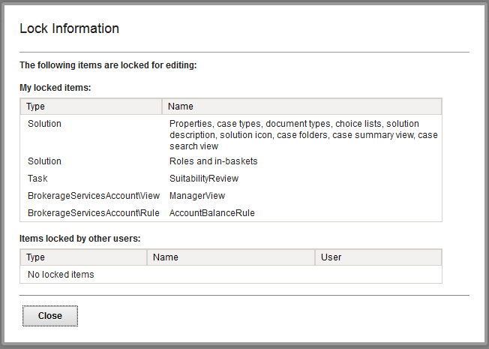
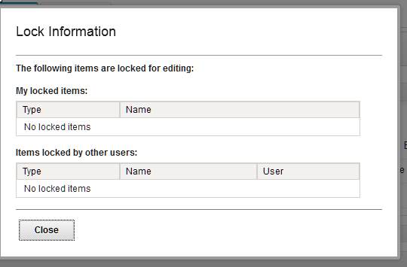
Checking locks when no changes are done
You can check the locked / unlocked status of the artifacts using “show locked items”.
If no changes are made, the list should be blank.

Slide 12
Course Roadmap
  Task property support
  Unlock solution artifacts when there are no changes
  Reflect reused property updates from Target Object Store
  LTPA token expiry handling
  Solution design performance improvements in Case Builder
  Embedded rules improvements

Slide 13
  Reflect reused property updates from Target Object Store
Prior to 5.2.1 if a TOS property is used in a solution,
  Any changes made to the property in the TOS were not reflected in the solution
  Redeploying the solution without replicating the property changes in the solution, would erase the changes in the TOS
In 5.2.1, when a reused property is changed in the Target Object store, the changes are reflected in the solution as soon as the solution is opened in Case Builder.
The following attributes for the reuse property changes are updated automatically when a solution is opened:
  Reuse choice list (choice item addition/deletion/update)
  Reuse property default value
  Reuse property maximum and minimum value (for Float and Integer)

Slide 14
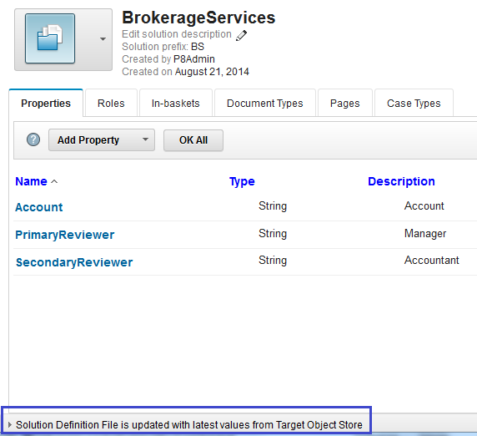
  Reflect reused property updates from Target Object Store
If a reuse property is updated in the Target Object store, a message is shown in the message bar that the solution definition file is updated with the latest changes from the Target Object Store.

Slide 15
Course Roadmap
  Task property support
  Unlock solution artifacts when there are no changes
  Reflect reused property updates from Target Object Store
  LTPA token expiry handling
  Solution design performance improvements in Case Builder
  Embedded rules improvements

Slide 16
  LTPA token expiry handling
Prior to 5.2.1 if the WAS LTPA token (Light weight Third Party Authentication) expired,
  Any unsaved changes for the solution in Case Builder were lost as the solution could not be saved due to authentication error.
  Other major operations like refresh solutions, edit, copy, commit solution, and open Step Designer could not be performed.
In 5.2.1, you are prompted to provide credentials if the WAS LTPA token expires,
  When you try to perform an operation that previously would have failed, a Login prompt dialog is shown instead.
  Once the credentials are validated a new LTPA token is generated and then Case Builder retries the failed operation.

Slide 17
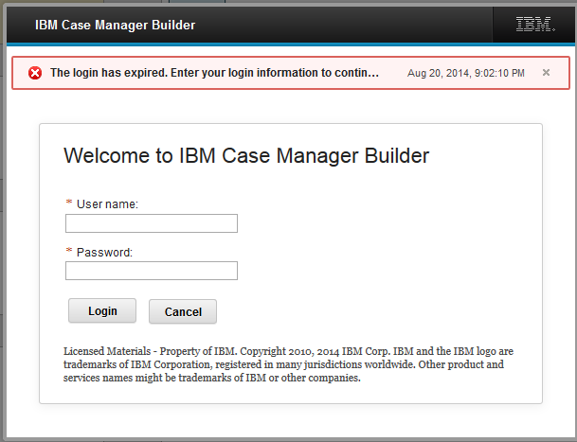
  LTPA token expiry handling
The below is the Login dialog that get displayed when the LTPA token expires

Slide 18
Course Roadmap
  Task property support
  Unlock solution artifacts when there are no changes
  Reflect reused property updates from Target Object Store
  LTPA token expiry handling
  Solution design performance improvements in Case Builder
  Embedded rules improvements

Slide 19
Other Performance and Usability improvements
Other Performance and usability improvements in Case Builder include,
  Faster updates to Lock/Unlock objects
    Implemented cache of Solution lock object
  Better response while navigating between tabs
  Streamlined backend code while invoking CE API calls
    Implemented cache of CE session data
  Improved login performance while loading widgets
    Implemented compression of CSS and ILOG widgets

Slide 20
Performance data (measured by FVT)
In comparison to ICM 5.2.0, the timings are now in milliseconds for ICM 5.2.1 in most Case Builder scenarios.
Observations based on measurements done by FVT:
  Login to case builder and manage solutions page takes less than 18 secs (was 3.11mins in ICM 5.2.0)
  Moving between tabs happens Instant in Milliseconds
  Editing the artifacts, click on Ok,cancel etc in milliseconds
  Save, Validate, save and close and commit takes just 1 to 2 seconds ( Major improvement compared to ICM 5.2.0)
  Deploying the solution takes almost a min for the first time and 20 secs and less for subsequent times ( Similar to ICM 5.2.0 )

Slide 21
Course Roadmap
  Task property support
  Unlock solution artifacts when there are no changes
  Reflect reused property updates from Target Object Store
  LTPA token expiry handling
  Solution design performance improvements in Case Builder
  Embedded rules improvements

Slide 22
Embedded Rules Improvements
Improvements have been made in two areas
In the table-based rule authoring capabilities
Embedded rules runtime performance

Slide 23
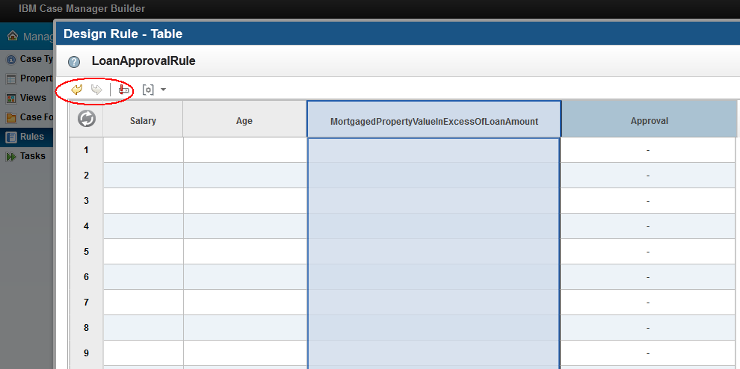
Embedded Rules Improvements
Table-based rules have been improved
Undo
Redo
Preconditions

Slide 24
Embedded Rules Improvements
Preconditions enable you to test data before executing rules inside a decision table
If the preconditions are not satisfied, the rules in the table are not executed
Use preconditions to declare variables that can be used in the decision table rules

Slide 25
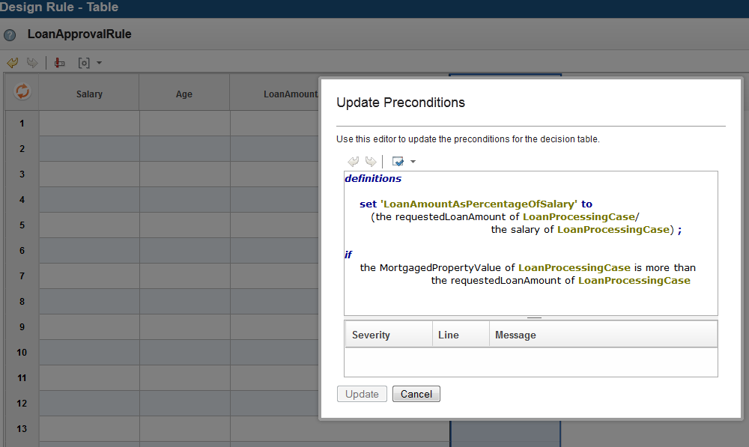
Defining Preconditions - Example

Slide 26
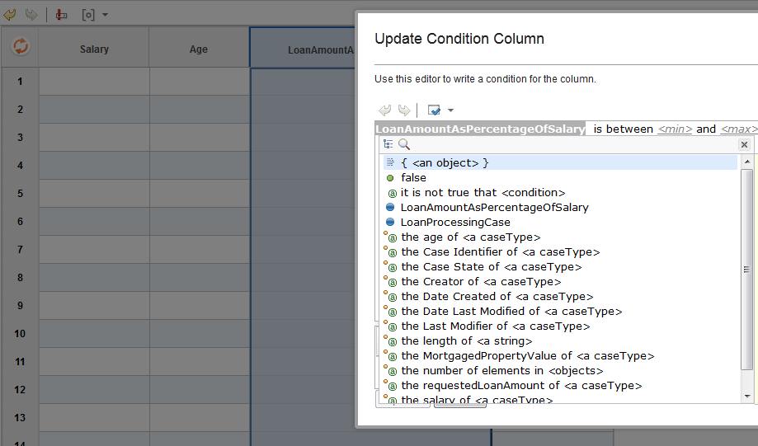
Making use of variables defined in Preconditions - Example

Slide 27
Course Summary
You have completed this course and can know of these enhancements:
Task Properties and In-basket improvements
Usability and performance improvements in the Case Manager 5.2.1
Embedded Rules improvements

Slide 28
Contacts
Product Marketing Manager:
William (Doc) Mills (wdocmills@us.ibm.com)
Product Manager:
Dave Perman (dperman@ca.ibm.com)
Support:
Ted Dullanty (tdullanty@us.ibm.com)
Subject Matter Experts (SME)/Area of Expertise:
Srinivas Jandhyala, Sanjay K Balupala, Ravi Ray, Vishnu N KV

Slide 29
Product Help/Documentation/Resources
IBM Case Manager 5.2.1 Knowledge Center
  http://www.ibm.com/support/knowledgecenter/SSCTJ4_5.2.1/com.ibm.casemgmttoc.doc/casemanager_5.2.1.htm
IBM Case Manager 5.2 Information
  http://pic.dhe.ibm.com/infocenter/casemgmt/v5r2m0/index.jsp
IBM Content Navigator 2.0.3 Knowledge Center
  http://www.ibm.com/support/knowledgecenter/SSEUEX_2.0.3/contentnavigator_2.0.3.htm
IBM FileNet 5.2 Knowledge Center
  http://www.ibm.com/support/knowledgecenter/SSNW2F_5.2.0/com.ibm.p8toc.doc/filenetcontentmanager_5.2.0.htm
IBM Support: Fix Central
  http://www.ibm.com/support/fixcentral/

